Slide 1
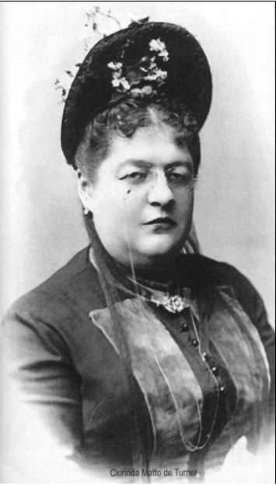
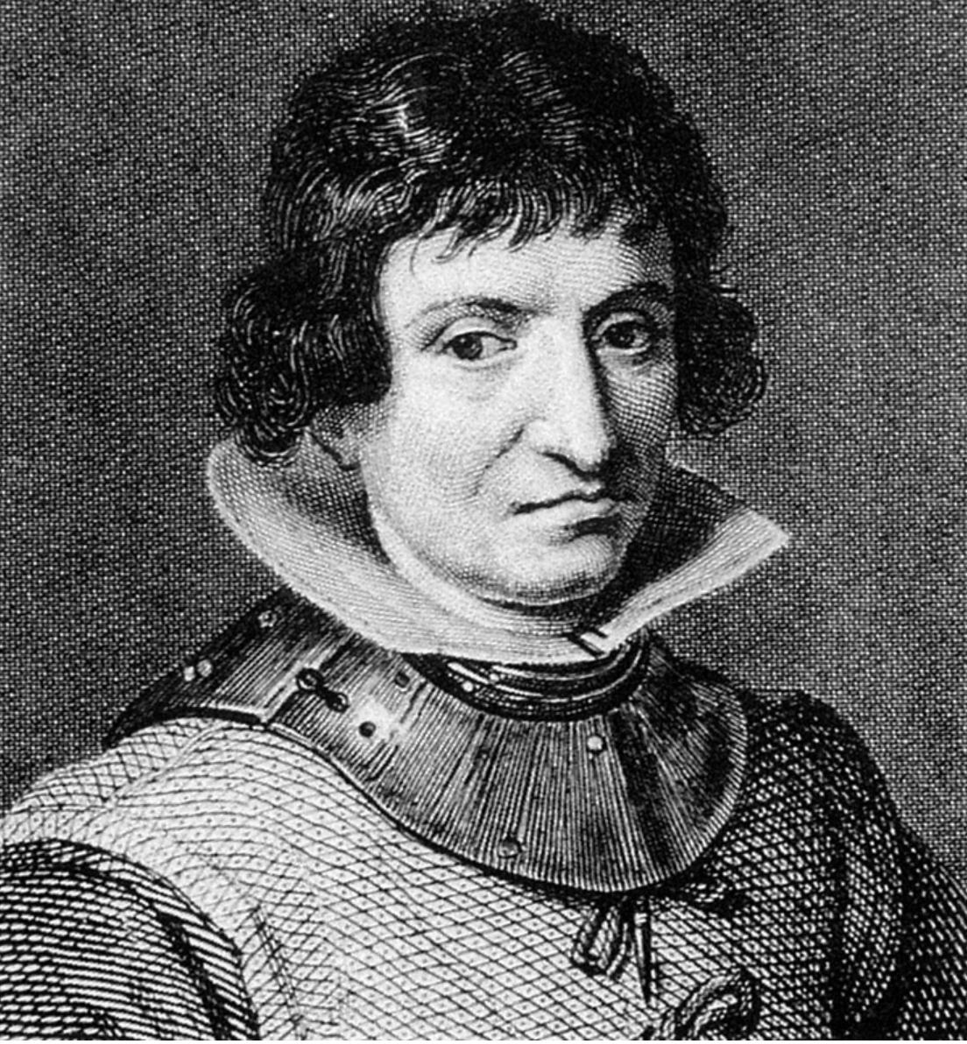
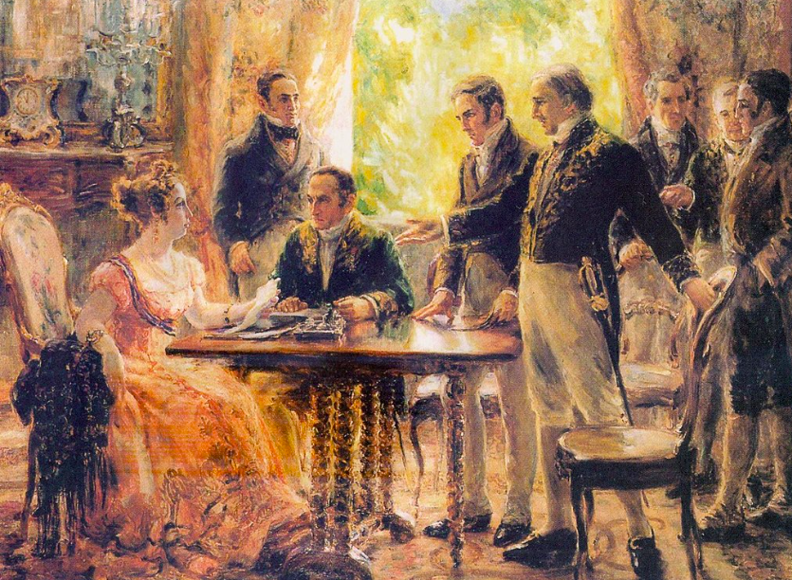
Suzanne M. Litrel
AHA 2026
suzannelitrel.com
Women on the Move, Women at Work: Teaching Latin America in World History
Catalina de Erauso/ Dom Antonio
(1585/92-c.1650)
Princess/Empress of Brazil
Maria Leopoldina
(1797-1826)
Clorinda Matto de Turner (1852-1909)

Slide 2
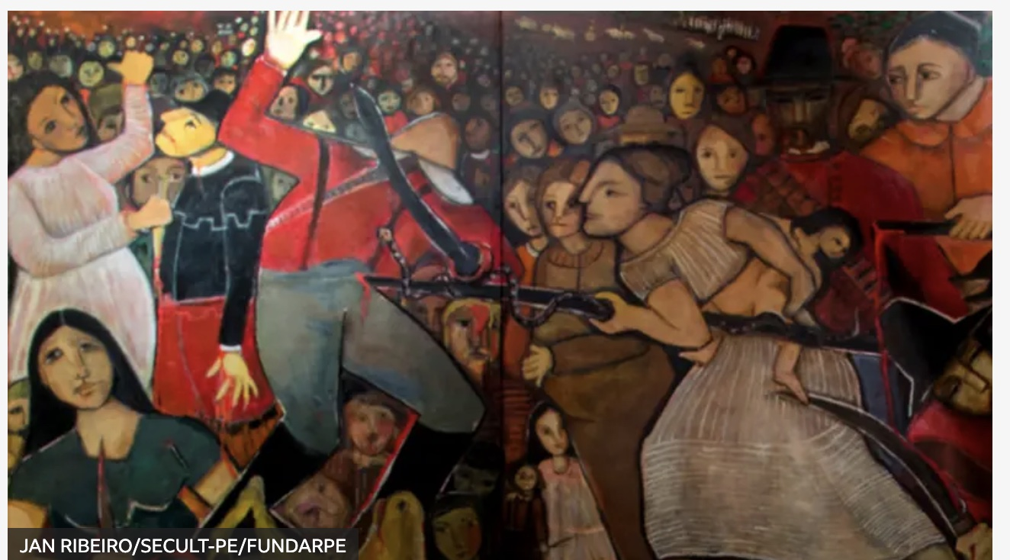
Considering world history through the lens of
Latin American women’s experiences
Historical imagination and collective memory
“Women of Tejucupapo”
Tereza Costa de Rêgo (2015)
Source: BBC Brasil
Notes:
Image of the “Women of Tejucupapo” by Teresa Costa de Rêgo, 2015
Source: BBC Brasil

Slide 3
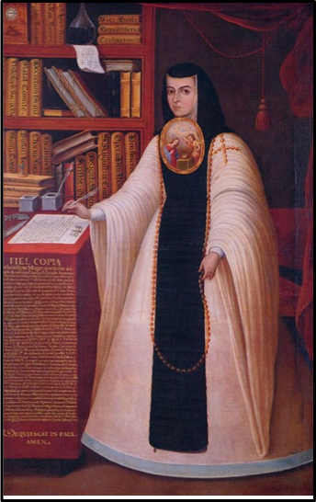
Women in Latin American History
Local, regional, and
world-historical connections
Juan Miranda (1713), oil on canvas. Located at the Universidad Nacional Autónoma de México (UNAM, Rectoría)
Note: Painting commissioned by fellow nun and Sor Juana’s spiritual daughter” who served as bursar. For display in the accounting office

Slide 4
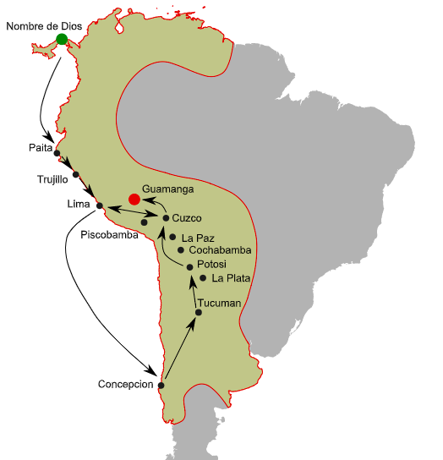
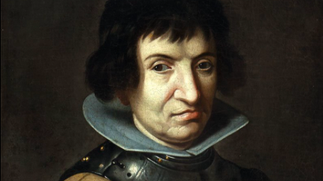

Catalina de Erauso, the
”Lieutenant Nun” (1592-1650)
1. Options: Convent or Conquest?
2. Don Antonio/Catalina

Slide 5
In her words:
Antonio/Catalina finds work with a treasury agent for Panama, and later works for a merchant receiving goods and sending them on. She conducts business on his behalf in the city of Trujillo:
With another book like the one I had used …containing information about the stock, the prices, and the accounts of credit.
Catalina/Antonio becomes a soldier and fights in the Battle of Valdivia (1820):
I had taken a bad blow to the leg, but I killed the [Mapuche] chief who was carrying the [company] flag, pulled it from his body and spurred my horse on, trampling and killing and slaughtering more men than there are numbers—but badly wounded, with three arrows in me and a gash from a lance in my left shoulder which had me in great pain—until at last I reached our own lines and fell from my horse.

Slide 6
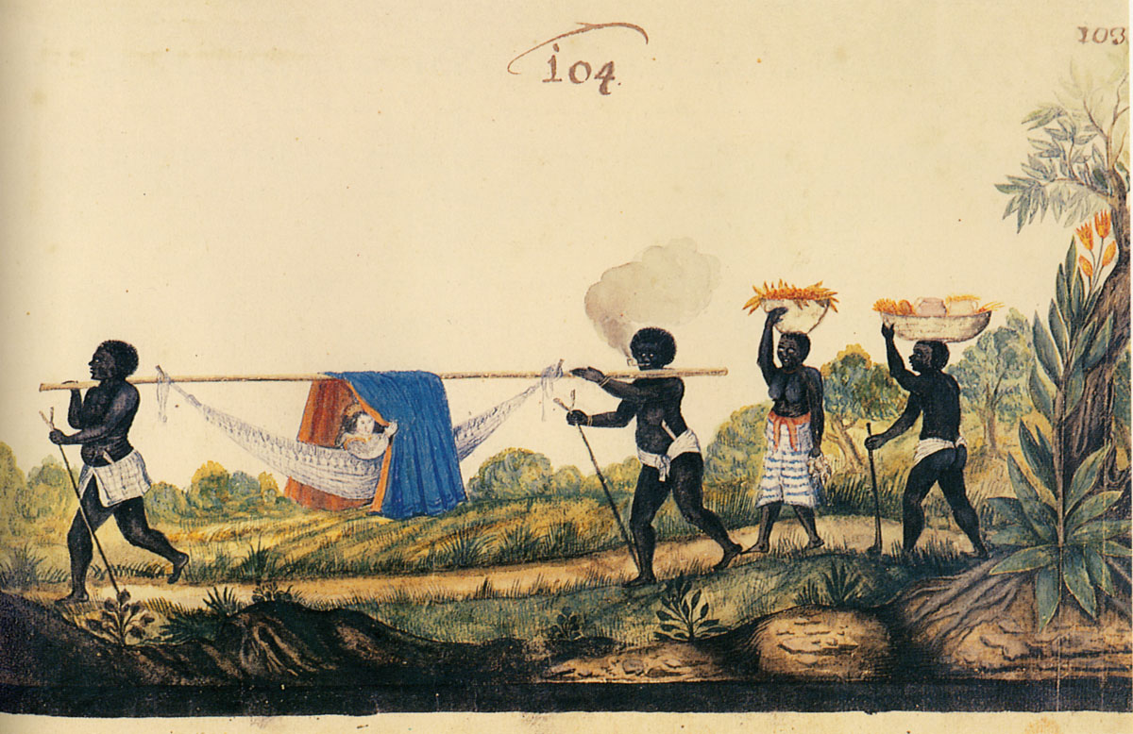
17thc Portuguese woman in
Dutch-held Brazil
Painting by WIC soldier
Zacharias Wagener, c. 1630

Slide 7

Women and Revolution
The unexpected role of
Dona Maria Leopoldina
Habsburg Princess
and
Empress of Brazil
(1796-1826)
Acting head of state Princess Maria Leopoldina
meets with the Council of State
9/2/1822 decision: Brazil should separate from Portugal

Slide 8
Pedro, Brazil is like a volcano. Even in the palace there are revolutionaries. Even the Portuguese are revolutionaries. Even commanders of the troops are revolutionaries. The Portuguese Cortes order your immediate return, threaten and humiliate you. The Council of State recommends you stay. As a woman and wife, my heart senses disgrace if we leave now for Lisbon…
In your hands, Brazil will be a great country. Brazil wants you as monarch. With or without your support, [Brazil] will separate. The apple is ripe, pluck it now, or it will rot … Pedro, this is the most important moment of your life…. You have the support of all of Brazil, and there is nothing the Portuguese soldiers can do against the will of the Brazilian people.
--Princess Leopoldina to Dom Pedro, 2 September 1822
Note: My translation. José Theodoro Mascarenhas Menck, D. Leopoldina, Imperatriz e Maria do Brasil: obra comemorativa dos 200 anos da vinda de D. Leopoldina para o Brasil (Brasília: Mesa da Câmara dos Deputados, 2017): 80-81.

Slide 9
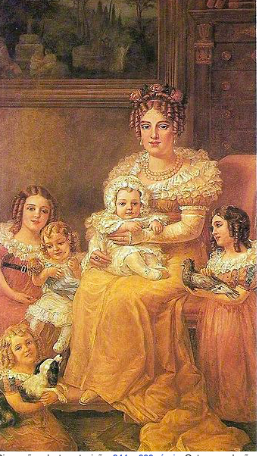
Tie-ins? Change and continuity, global feminism, diplomacy
“Session of the Council of State” (1922)
Georgina de Albuquerque , Muséu Histórico Nacional
Prize-winner, Exposition of Contemporary Art and Retrospective Art of the Independence Centenary
“Empress Maria Leopoldina of Brazil
with her children” (1921)
Domenico Failutti, Museu Paulista da USP

Slide 10
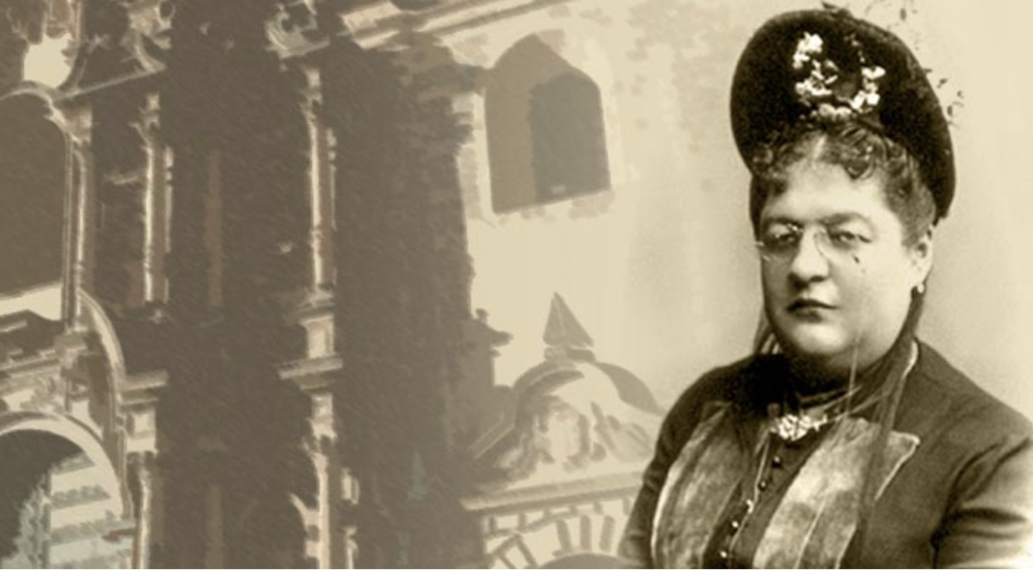
Nation-Building
Focus: Peru
Clorinda Matto de Turner (1852-1909)
Peruvian writer, editor, novelist, playwright, publisher and exile (from 1895)
Primary Source analysis: images (photos, advertisements, paintings) literature
World Historical Themes/Topics/ Focus
Nation-building: gendered roles
Modernization and the global economy
Justice and reform for women, indigenous (tie-in to global feminism)

Slide 11
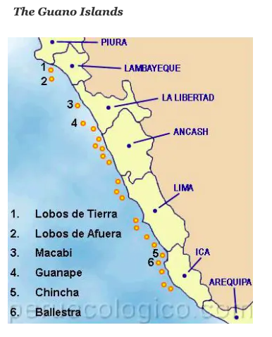
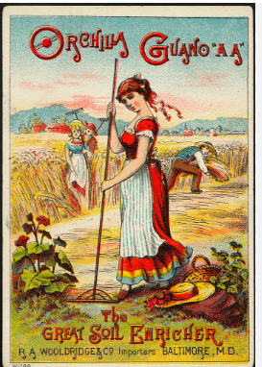
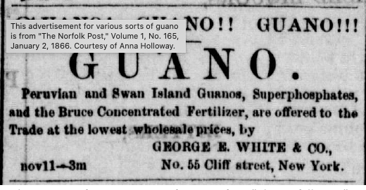
Visions of Modernity:
Peru in the “Age of Guano”:
c.1840-1880
The Peruvian “Miracle” of export-oriented growth
guano boom … and bust

Slide 12
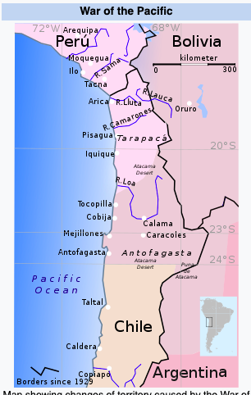
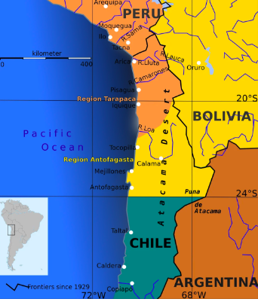
War of the Pacific (1879-1884)
Regional conflict over saltpeter (another nitrate!)
Atacama desert rights domestic alliances
Peru, Bolivia
Lima’s humiliation: Chilean soldiers take the city

Slide 13
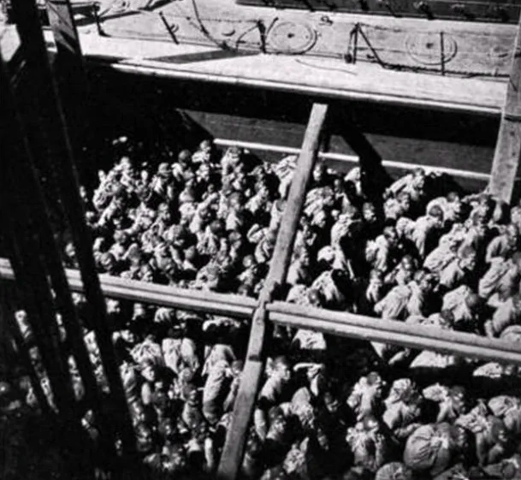
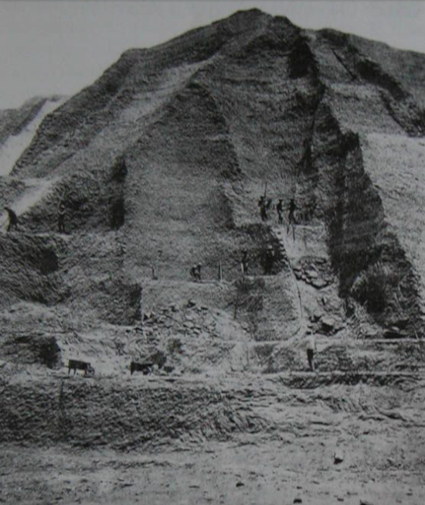
British role in supplying Chinese labor
Connection to upheavals of late Qing dynasty (Taiping Rebellion, Opium Wars)?

Slide 14
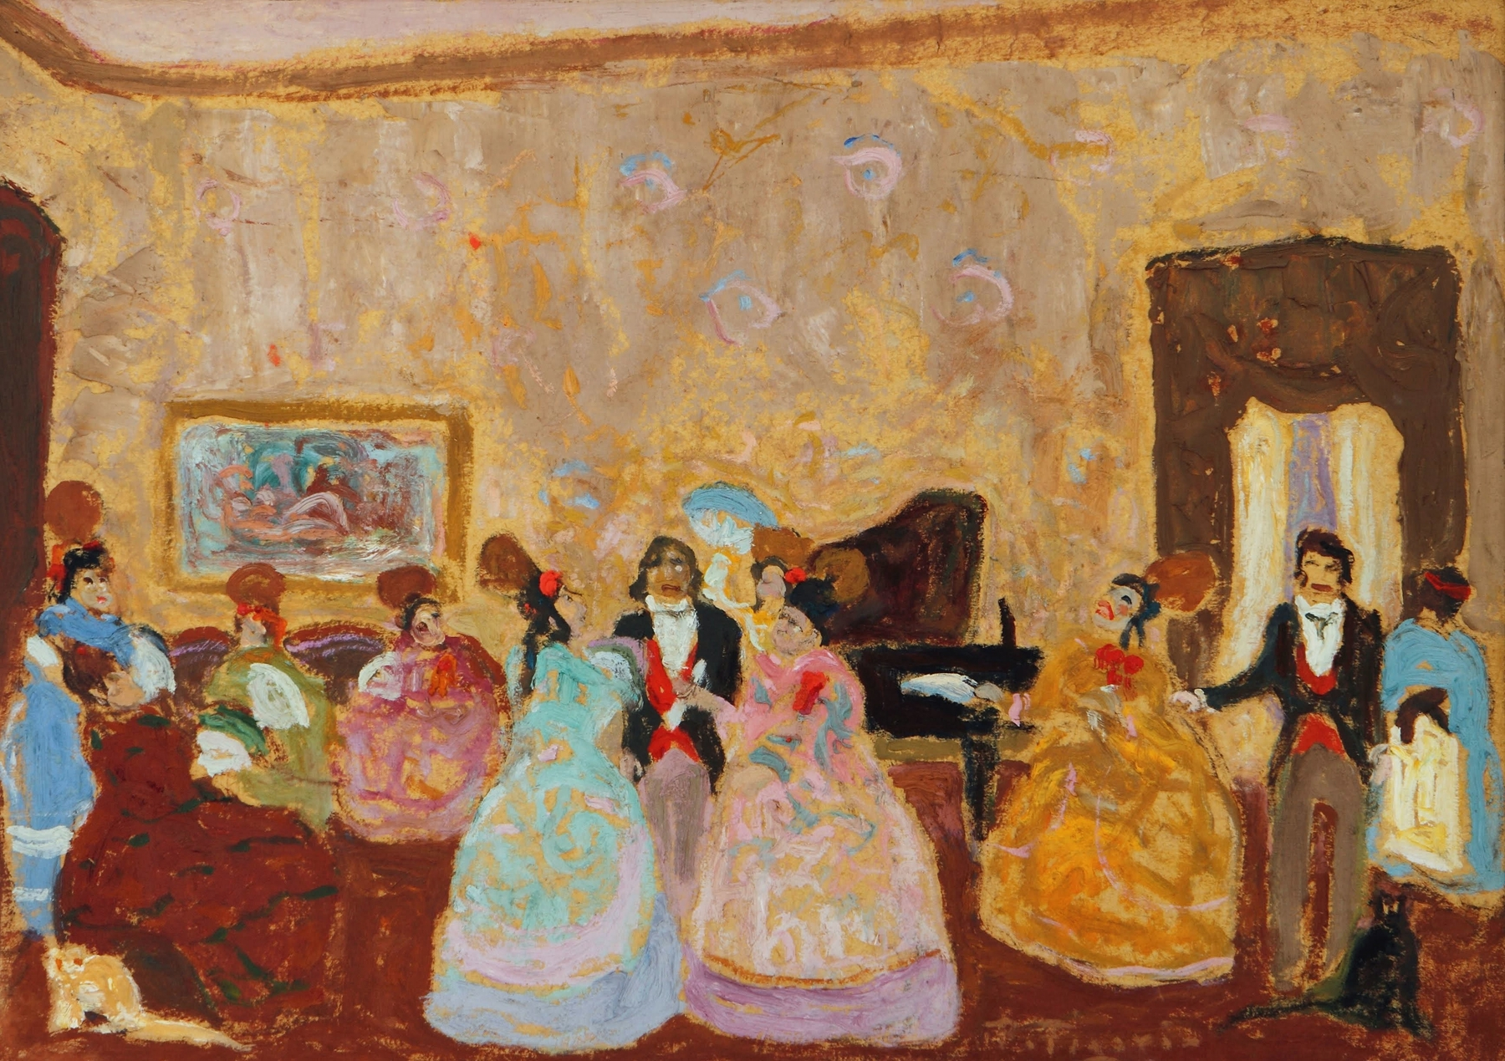
Clorinda Matto de Turner
(1852-1909) and “Women’s Work”
* Writer, editor, novelist, playwright
*exiled author and editor (from 1895)
Themes/Topics/ Focus
Peruvian culture
Education
Justice and reform for women, indigenous
Anti-Church
“Tertulia” (c. late 19thc), Pedro Figari

Slide 15
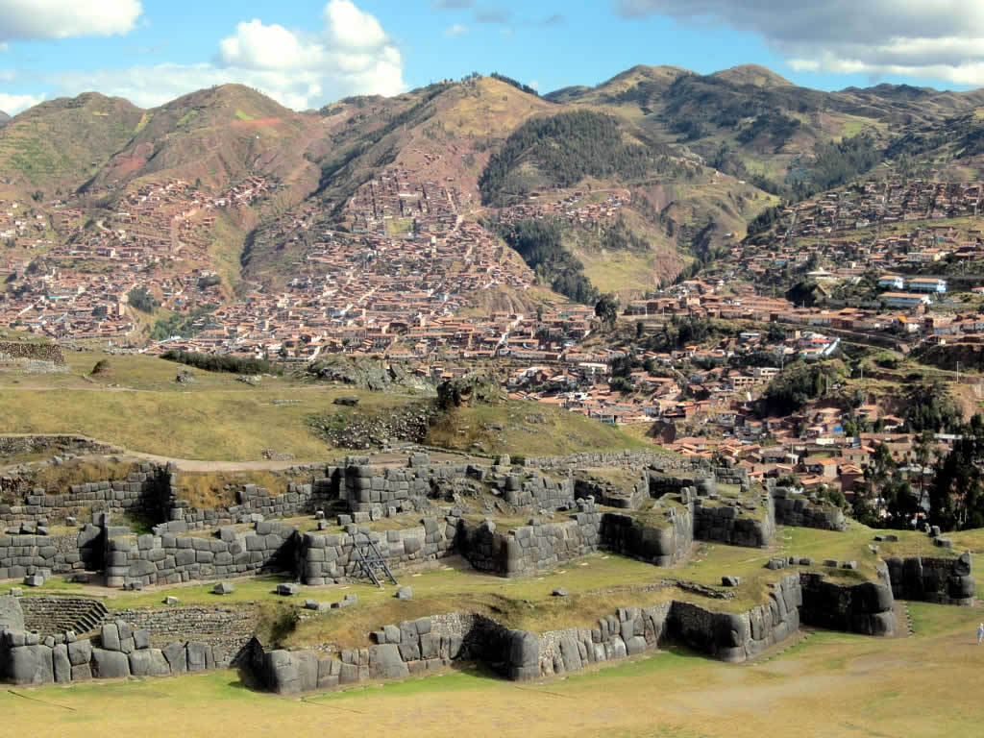
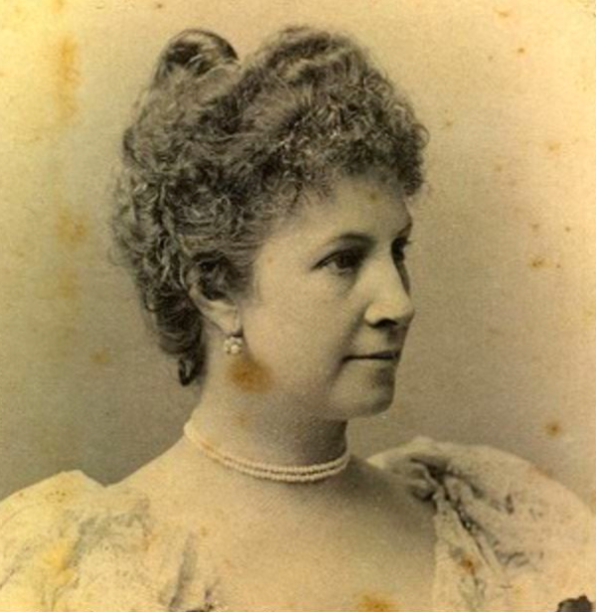
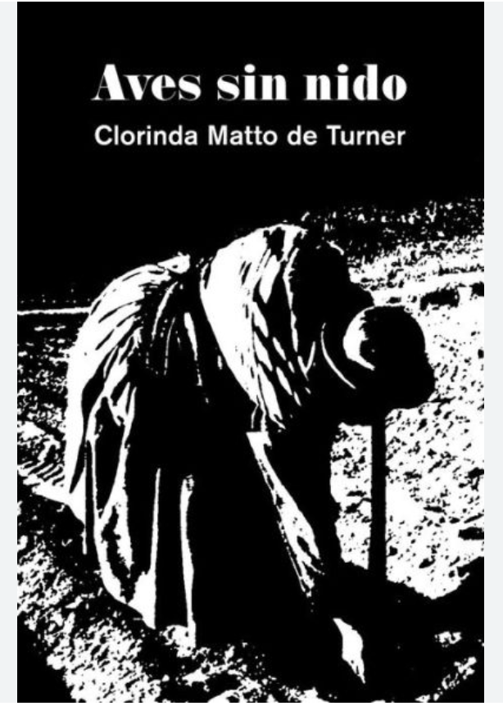
Clorinda Matto de Turner:
Earning a living, demanding reform
1881: handling husband’s
death and debt
1884: first woman editor
of a daily newspaper
in the Americas
(La Bolsa)
1889: Publication of
Birds Without a Nest
first indigenist novel
from the Americas
How did a motherless “mountain girl” from Cusco (Cuzco) become one of the leading literary figures, editors, and activists in and beyond Latin America?

Slide 16
From Birds without a Nest (Aves Sin Nido)
In the following scene, Marcela and her daughter Margarida pay a visit to Father Pascual to pay him off and do service:
“Where did you find this young girl so pretty and plump?”
“She is my daughter, Father,” replied Marcela.
…
“And how old is she?”
“I have counted some fourteen years since her baptism, señor padre.”
“Ah then it was not I who sprinkled her [with holy water]; it is hardly six years since I came. And, well, this year you will put her in service of the church, will you not? She can begin by washing dishes and attending to other little things.”
“Father!”
“And you, lazy one, when do you begin the mita? Is it not already your turn?” Said the priest, fixing his eyes on Marcela and getting familiar with her, patting her on the back.
“Yes, Father,’ said the woman trembling.

Slide 17
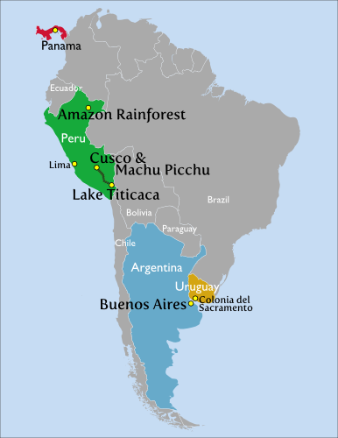
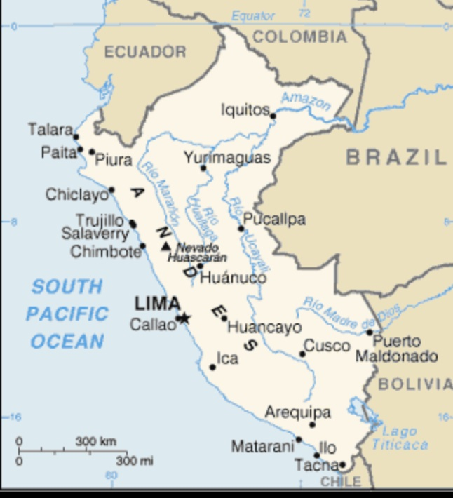
Clorinda Mattos de Turner: a 19thc author-editor-activist on the move

Slide 18
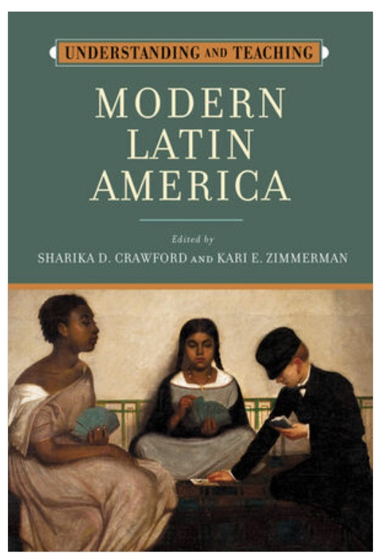
For more information, and a closer look at strategies in teaching Latin America….

